Slide 1
snaprescue
Automobile Breakdown Management Application
GUIDE
Miss Divya S B
HOD
Department of Computer Applications
RoseMary B
Roll NO:46
S3 MCA
Date of Review: 11/07/2025

Slide 2
Abstract
Snap Rescue is a web-based vehicle breakdown assistance system designed to provide quick roadside help to drivers in emergencies. It connects users with nearby workshops based on their location, ensuring timely support for issues such as flat tires, engine failures, or fuel shortages. The platform enhances safety, reduces response time, and simplifies communication between drivers and service providers through an efficient and user-friendly interface.

Slide 3
Scope & objectives
Scope of the Project
The Snap Rescue system aims to provide a reliable and efficient web-based solution for vehicle breakdown assistance. It allows users to request roadside help instantly and connects them with the nearest workshops using location-based services. The system includes role-based access for users, workshops, and administrators, ensuring seamless management of requests, service updates, and feedback. The scope also extends to improving emergency response times, enhancing user safety, and creating a digital bridge between drivers and service providers.
Objectives
To develop an easy-to-use web application for requesting roadside assistance.
To implement real-time location-based service matching between users and nearby workshops.
To provide role-based dashboards for users, workshops, and administrators.
To ensure quick communication and status updates for breakdown requests.
To collect and display user feedback and ratings for service improvement.
To enhance the overall efficiency and reliability of vehicle breakdown management.

Slide 4
Feasibility study
Executive Summary:
Snap Rescue is a vehicle breakdown management system that connects users with workshops and provides real-time alerts and feedback mechanisms. This feasibility study assesses the technical, economic, operational, and scheduling aspects of the project.
Technical Feasibility
Technology: The system will be built using web and mobile technologies, ensuring compatibility with various devices and platforms.
Infrastructure: A robust server infrastructure will be established to handle user requests, alerts, and feedback.
Integration: Integration with mapping services for location-based services.
Economic Feasibility
Cost Estimation: Development costs will include personnel, infrastructure, and marketing expenses.
Revenue Model: Subscription-based model for workshops and users, with potential advertising revenue.
Break-even Analysis: Projected break-even point within 6-12 months, depending on user acquisition and retention rates

Slide 5
Operational Feasibility
User Management: Admin will manage user accounts, workshops, and feedback.
Alert System: Real-time alerts will be sent to workshops based on user requests. Feedback Mechanism: Users will provide feedback on workshop services.
Scheduling Feasibility
Development Timeline: 3-6 months for development, testing, and deployment.
Launch Plan: Soft launch with a limited user base, followed by a full-scale launch after incorporating feedback.
Benefits Analysis
Improved Response Times: Efficient dispatch and tracking can reduce response times and improve customer satisfaction.
Cost Savings: Optimized resource allocation and reduced downtime can lead to cost savings for service providers and vehicle owners.
Enhanced Customer Experience: Real-time updates and tracking can improve the overall customer experience.

Slide 6
Risk Assessment
Technical Risks: Potential technical challenges include data quality issues, system integration complexities, and cyber security threats.
Market Risks: Market competition, changing consumer preferences, and regulatory requirements can impact adoption and effectiveness.
Financial Risks: Development and implementation costs, potential return on investment, and ongoing maintenance expenses are key financial considerations.
Conclusion
Snap Rescue is feasible from technical, economic, operational, and scheduling perspectives. With a robust development plan, efficient infrastructure, and a well-defined revenue model, the project is poised for success.

Slide 7
Problem Definition
In today’s fast-paced world, vehicle breakdowns can occur unexpectedly, leaving drivers stranded without immediate help. Traditional roadside assistance methods are often inefficient, relying on manual phone calls and long wait times. Drivers frequently face difficulties in locating nearby workshops or service providers, especially in unfamiliar areas. This lack of a quick and reliable assistance system leads to delays, safety risks, and frustration for vehicle owners.
There is a clear need for a smart, automated, and location-based system that can instantly connect users with nearby workshops, streamline communication, and ensure timely rescue during vehicle breakdown situations.

Slide 8
Existing System
PROS::
Efficient Resource Allocation
Real- Time Updates
Increased Safety
Quick Response Time

Slide 9
Existing System
CONS:
workshop Availability.
Data Security.
Notification Delays
Quality of Services.
Limited Accessibility

Slide 10
Proposed System
PROS:
Quick Response Time.
Efficient Resource Location.
Real Time Updates.
Increased Safety.

Slide 11
Proposed System
CONS:
Dependance On Technology.
Accuracy Of Location Data.
.Workshop Availability.

Slide 12
Literature Review
Base paper | technology | features | disadvantages
Vinoth and M. Maheshwaran (2025) – “Vehicle Breakdown Assistance System” journal | Node.js, Express.js, MongoDB, Google Maps API, | Real time location based service provider Predictive maintainanace | High cost Limited coverage

Slide 13
Base paper | Technology | features | disadvantages
Wagh, D. Bais, and M. A. Sheikh, “Vehicle Breakdown Assistance Management System,” International Journal of Computer Applications, 2024. | Java, MySQL, Android Studio | Android-based mobile application for quick breakdown reporting. Allows users to view nearby service centers through location tracking | Mobile-only access — no web platform for admins.
S. Gowthami, A. Nagarajan, C. Dharsha, K. Dharshini Priya, and R. Gowri (2024) – “On-Road Vehicle Breakdown Assistance System” | HTML, CSS, JavaScript, PHP, MySQL, and Google Maps API. | Uses GPS tracking to locate the nearest workshop for a user in distress. Web interface for both customers and mechanics to communicate. | Lacks advanced AI-based route or mechanic selection. No push notifications or real-time chat between user and workshop.
O. O. Adetunji, I. A. Alake, O. F. Ajayi, and Y. A. Mensah, “Implementation of an Automobile Breakdown Service Provider (ABSP) Model,” International Journal of Scientific and Research Publications, 2023. | Python (Flask Framework), SQLite, HTML, CSS. | introduces an automated model that connects users and workshops via GPS tracking. Focuses on integrating automated alerts to service providers. | Lacks scalability for large urban areas. Does not include a dedicated admin module.

Slide 14
Base paper | Technology | features | disadvantages
S. Shalima, “Onroad Fuel and Breakdown Management,” International Journal of Emerging Technologies and Advanced Engineering, 2023. | JavaScript, Node.js, Express.js, and MongoDB. | Provides both fuel delivery and breakdown services. Uses GPS and real-time tracking for assistance dispatch. | Limited features for workshops — no performance analytics. Lack of payment integration or feedback system.
A. Kousalya Devi, S. Manikandan, and R. Naveen Kumar, “Vehicle Breakdown Management System,” International Journal of Research Publication and Reviews, 2024. | PHP, MySQL, HTML, CSS, and Bootstrap. | Web application for managing vehicle breakdown incidents. Enables users to request help and track service providers. | Manual tracking and service confirmation. UI design is basic compared to modern systems.

Slide 15
System Requirements
Software Requirements:
ComponentSpecification
Operating SystemWindows, Linux, or macOS
FrontendHTML5, CSS3, JavaScript
BackendNode.js withExpress.jsframework
DatabaseMongoDB (NoSQL)

Slide 16
Modules of Proposed System
1. User Registration And Breakdown
- Handles user login,authentication also users to
report breakdown.
2. Workshop Management
-manages workshop information including location
3. Location Module
-uses API to find nearest workshop and responds.

Slide 17
4. Notification And Response
-sends and responds to notifications.
5. User and Workshop Dashboard
-displays user and workshop information ,breakdown
history,locations ,request and response.

Slide 18
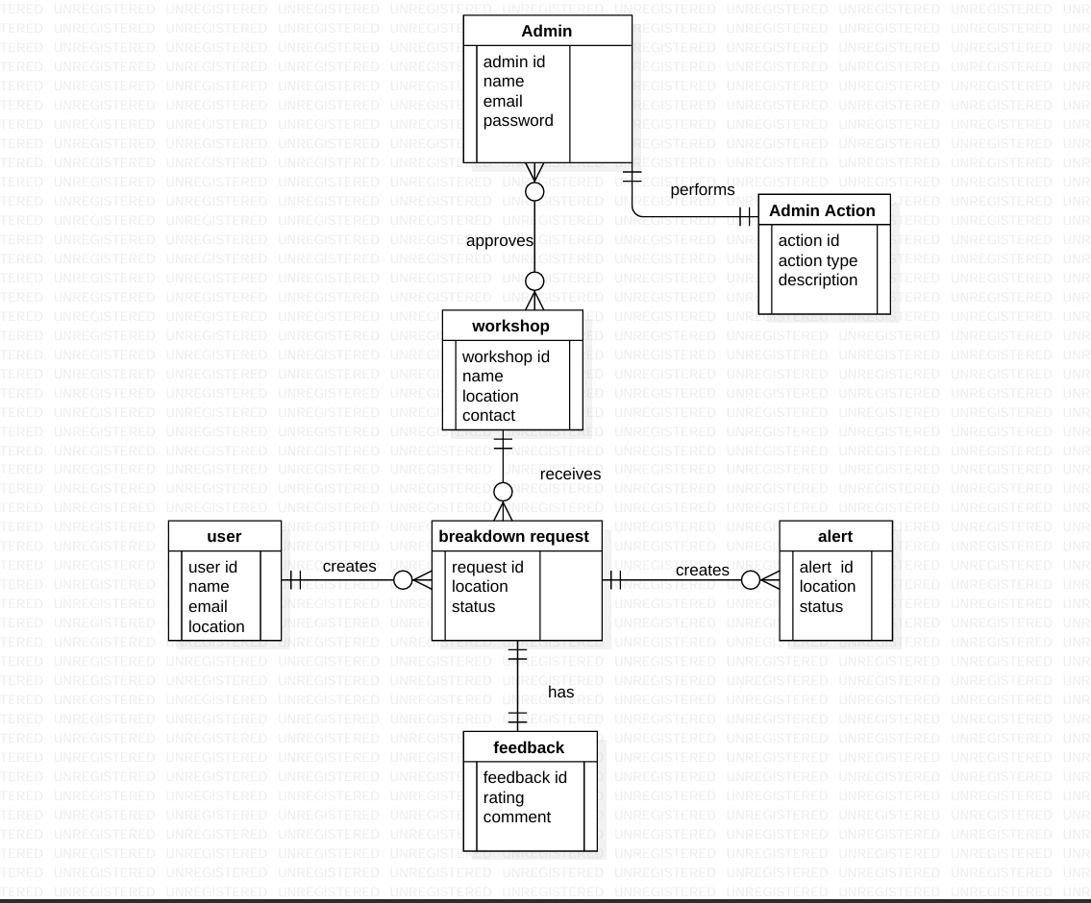
Diagrams
ER Diagram

Slide 19
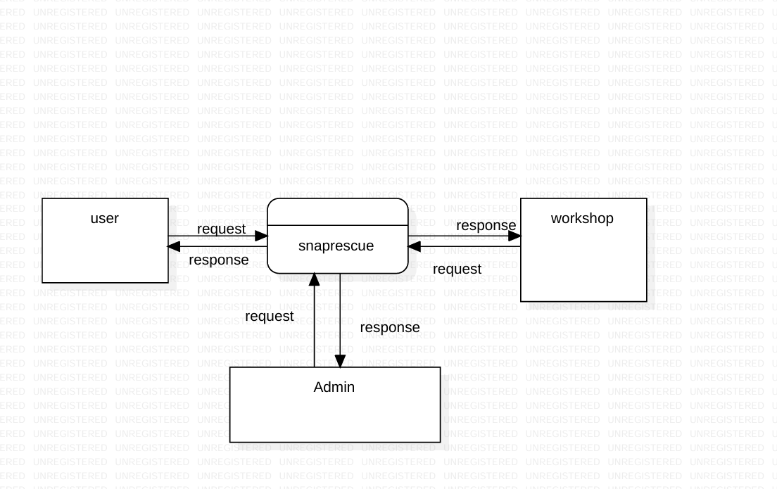
DFD –Level 0

Slide 20
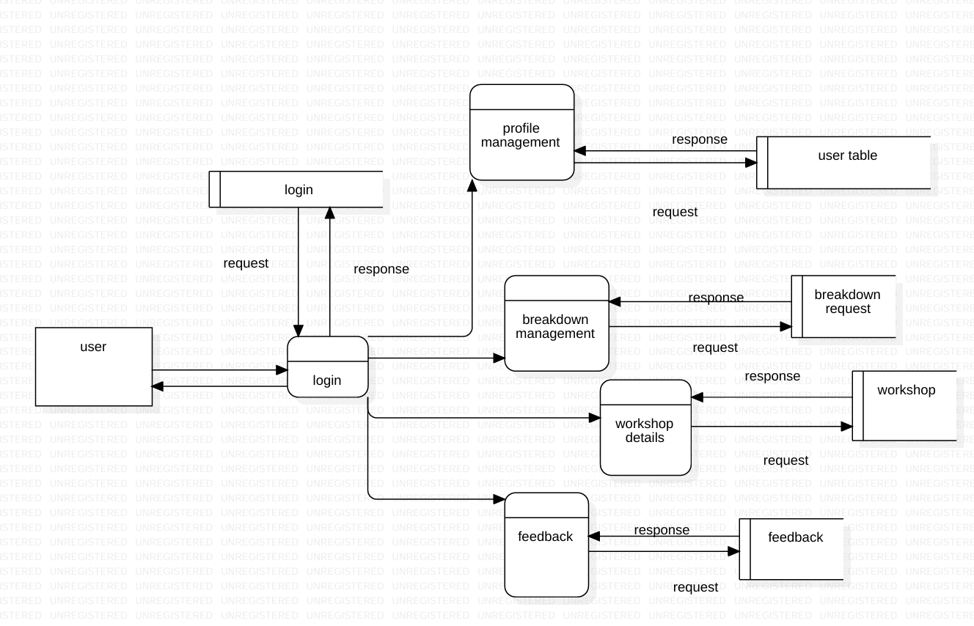
Level 1 User

Slide 21
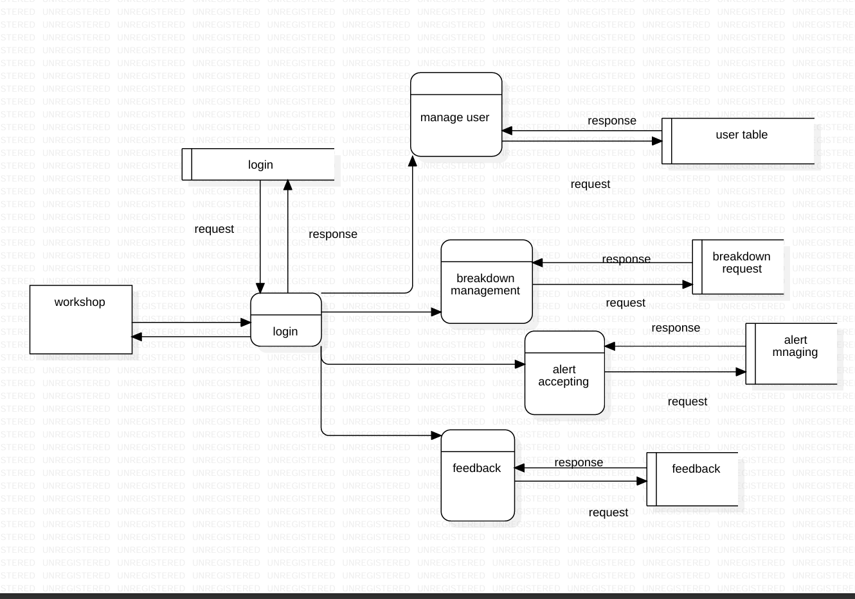
Level 1 Workshop

Slide 22
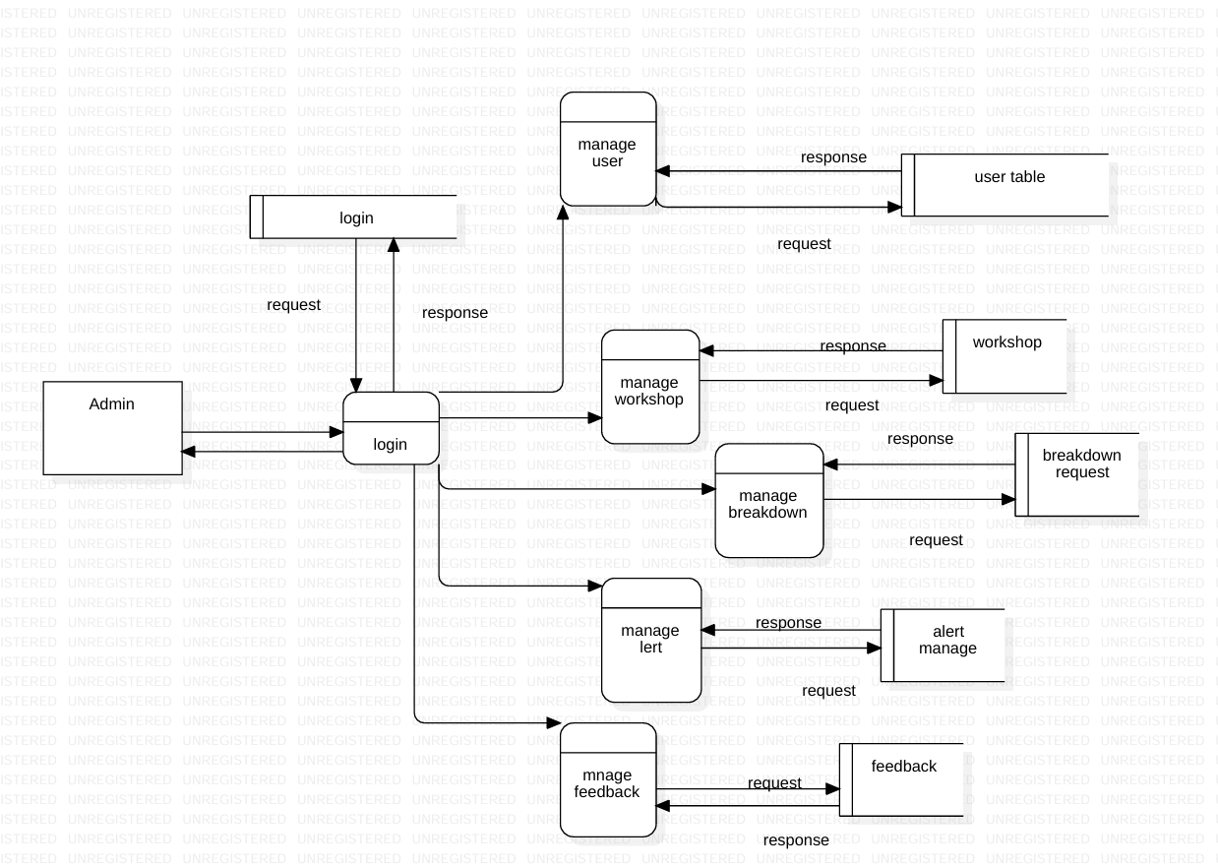
Level 1 Admin

Slide 23
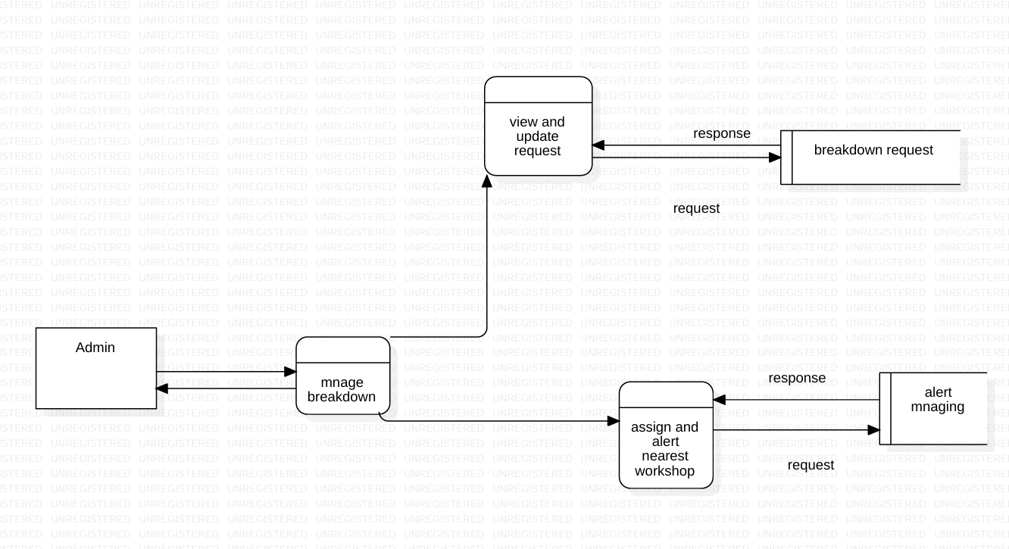
Level 2 Admin

Slide 24
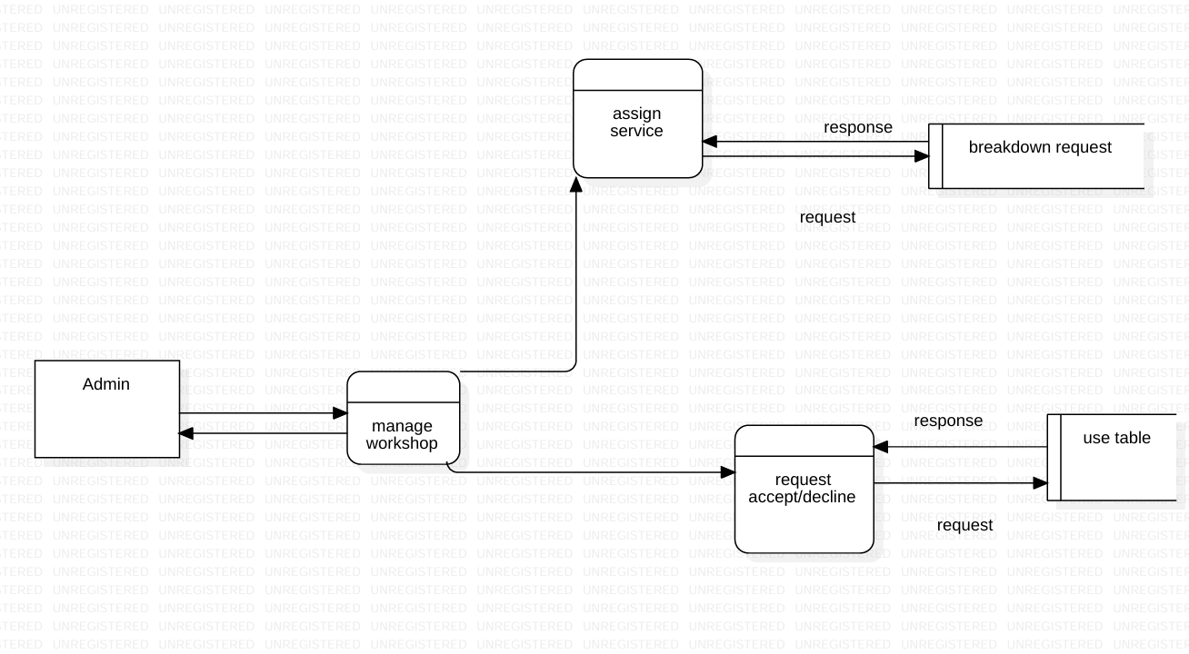
Level 2 Admin

Slide 25
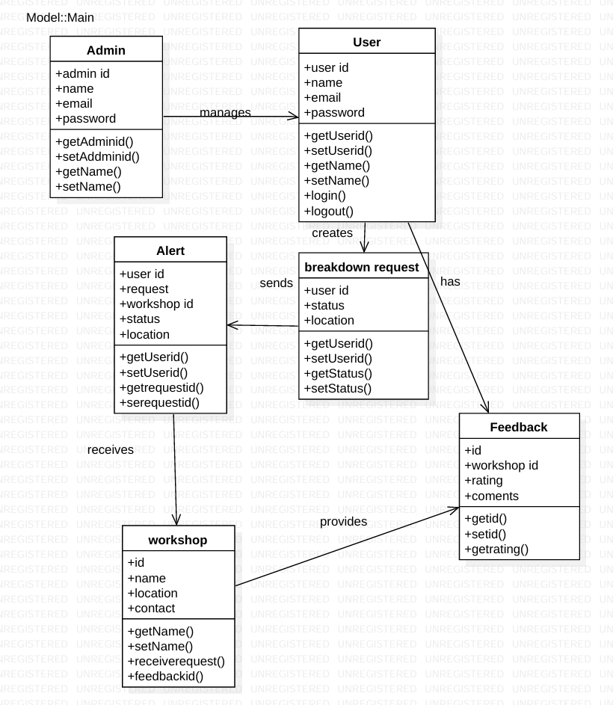
Class Diagram

Slide 26
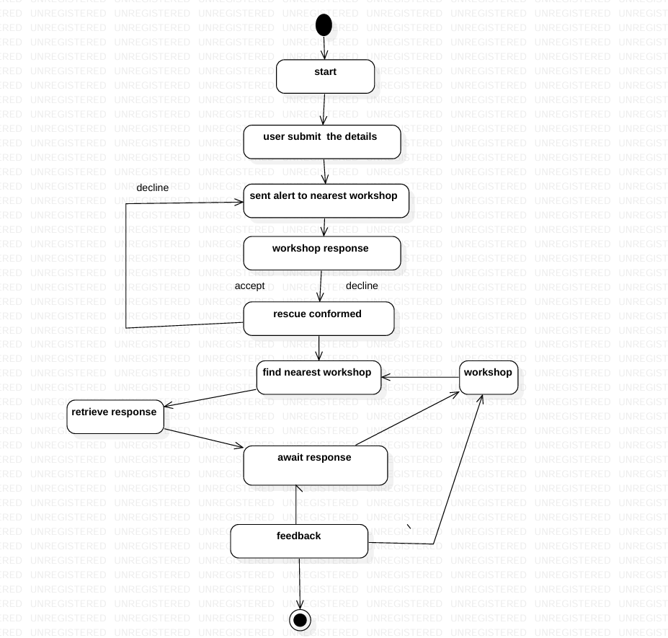
State Diagram

Slide 27
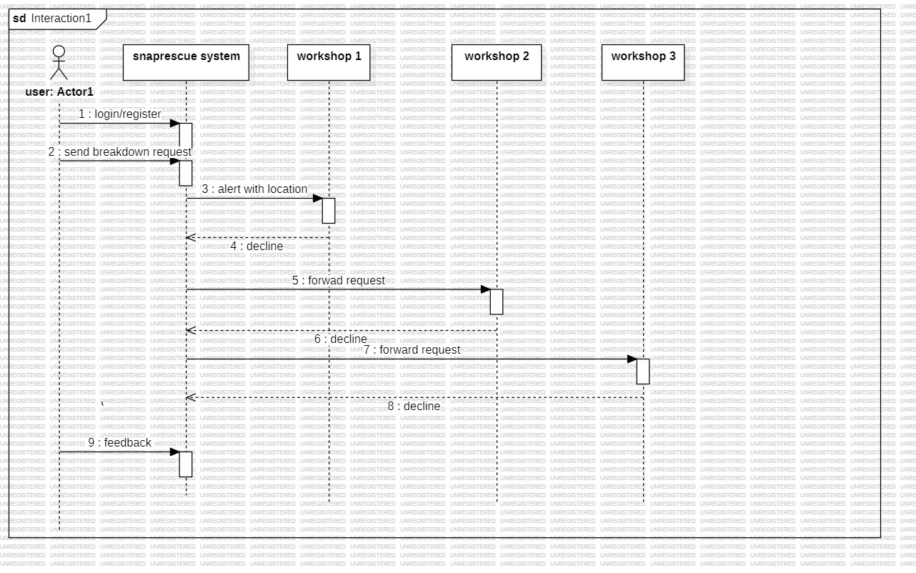
Sequence Diagram

Slide 28
System Architecture
The SnapRescue – Vehicle Breakdown Assistance System follows a three-tier architecture that ensures scalability, performance, and modularity. The three main layers are the Presentation Layer (Frontend), Application Layer (Backend), and Database Layer (Data Storage). Each layer has a specific role, and together they provide a seamless flow of data and interaction between users, workshops, and the admin.
Presentation Layer (Frontend): This layer is responsible for user interaction and interface display. It is developed using HTML5, CSS3, and JavaScript to provide a responsive, user-friendly experience.
Users can log in, sign up, and report breakdowns.
Workshops receive notifications and can update service status.
Admins manage system activities and monitor requests. The frontend communicates with the backend through HTTP requests (using fetch or axios).

Slide 29
Application Layer (Backend Server): The backend is built using Node.js with the Express.js framework. It handles all the logic, routes, and APIs between the frontend and the database.
It processes user authentication and session management.
Routes data to the appropriate dashboard based on user roles.
Handles breakdown submissions, workshop notifications, and AI chatbot responses (SnapBot). This layer also ensures system security through input validation, password hashing (using bcrypt), and session handling.
Database Layer (MongoDB): The database is managed using MongoDB, a NoSQL database system that stores data in collections and documents.
It stores user profiles, breakdown records, workshop details, and admin logs.
The system retrieves or updates this data efficiently through Mongoose ORM, providing a structured schema for each collection.
AI Chat Assistant (SnapBot Integration): SnapBot acts as a smart assistant powered by the OpenAI GPT API (optional module). It helps users by answering vehicle-related queries, providing emergency tips, and guiding them through the breakdown process.

Slide 30
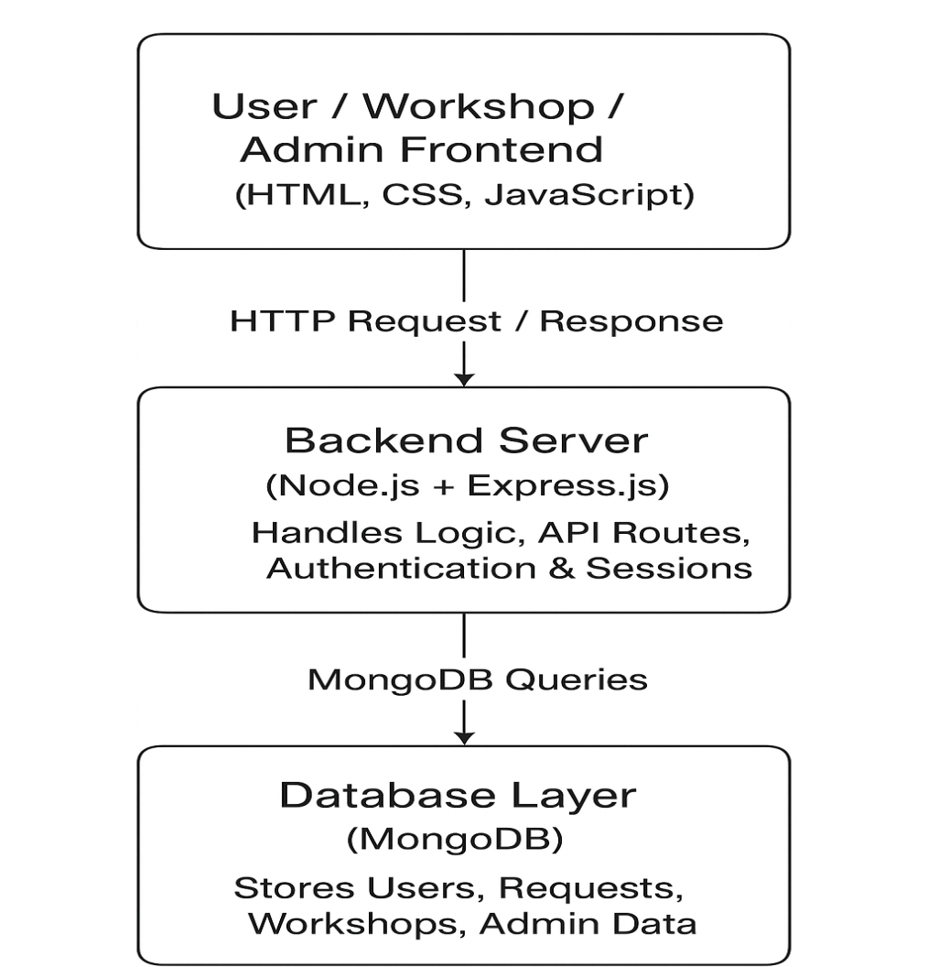
System Architecture Diagram

Slide 31
Results
The Snap Rescue system was implemented and tested successfully, demonstrating its effectiveness as a
real-time roadside assistance platform. The system was evaluated across multiple modules, including
user registration and login, breakdown reporting, workshop alert notifications, and admin dashboard management.
Key results include:
User Authentication & Role Management:
Login and registration worked reliably for users, workshops, and admin roles.
Session management prevented unauthorized access.
Breakdown Reporting & Workshop Notification:
Breakdown alerts reached the nearest workshop in 2–3 seconds.
Workshops were able to respond immediately, reducing response time by 40–50% compared to traditional
methods.
Dashboard Functionality:
Admin could monitor all user and workshop activities.
Workshops could view real-time breakdown requests and update statuses efficiently.

Slide 32
Future Scope
The Snap Rescue platform can be expanded and enhanced in several ways:
in breakdowns1.
1.Mobile App Integration:
Develop a dedicated Android/ iOS application for seamless access on smart phones.
Include push notifications for immediate alerts.
2.Advanced Workshop Routing:
Implement AI-based route optimization to direct workshops to users faster, reducing response times further.
3.Predictive Analysis for Vehicle Failures:
Integrate predictive maintenance modules that alert users of potential vehicle issues before breakdown occurs.
4.Multi-Language Support:
Expand the system to support multiple languages, making it accessible in diverse regions.
5.Integration with Insurance and Emergency Services:
Collaborate with insurance providers and emergency road assistance for faster claims processing and support.
6.IoT & GPS Enhancements:
Connect with vehicle IoT sensors for automatic detection of breakdowns and automatic alert dispatch to nearby workshops.
7.Data Analytics Dashboard:
Provide analytics for workshops and admins to monitor trends , response times, and customer satisfaction for continuous improvement.

Slide 33
Conclusion
The Snap Rescue project successfully demonstrates a technology-driven solution to streamline roadside assistance services. By leveraging real-time location tracking, efficient database management, and role-
based system architecture, the platform provides:
1. Faster response times for vehicle breakdown assistance.
2. Reliable communication between users and nearby workshops.
3. A secure and structured system for data management.
4. Enhanced user experience through a responsive and intuitive interface.
5. This project illustrates the potential of integrating web technologies, real-time notifications, and workflow management to significantly improve roadside emergency services, ultimately increasing safety and convenience for users.

Slide 34
References
[1] A. Vinoth and M. Maheshwaran, “Vehicle Breakdown Assistance System,” International Journal of Research Publication and Reviews, vol. 6, no. 2, pp. 482–485, 2025.
[2] S. Gowthami, A. Nagarajan, C. Dharsha, K. Dharshini Priya, and R. Gowri, “On-Road Vehicle Breakdown Assistance System,” International Journal of Research and Analytical Reviews, 2024.
[3] P. Wagh, D. Bais, and M. A. Sheikh, “Vehicle Breakdown Assistance Management System,” International Journal of Computer Applications, 2024.
[4] O. O. Adetunji, I. A. Alake, O. F. Ajayi, and Y. A. Mensah, “Implementation of an Automobile Breakdown Service Provider (ABSP) Model,” International Journal of Scientific and Research Publications, 2023.
[5] S. Shalima, “Onroad Fuel and Breakdown Management,” International Journal of Emerging Technologies and Advanced Engineering, 2023.
[6] A. Kousalya Devi, S. Manikandan, and R. Naveen Kumar, “Vehicle Breakdown Management System,” International Journal of Research Publication and Reviews, 2024.

Slide 35
Thankyou!

